Slide 1
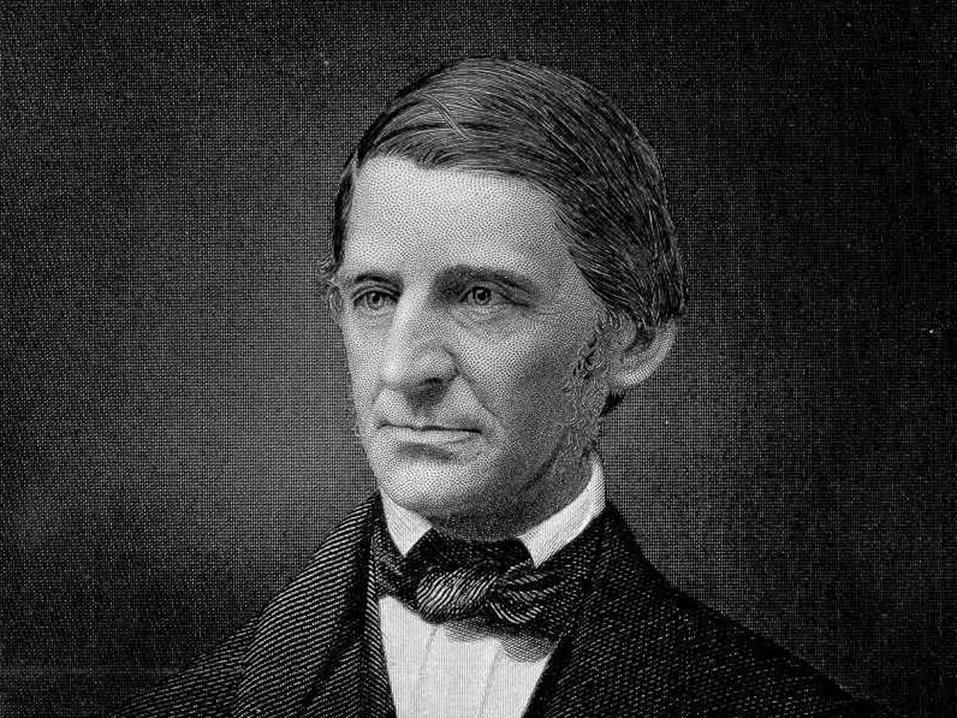
Transcendentalism
Emerson →
The Father of a Movement
AKA Mr. Haflin’s homies
Notes:
Use notes to supplement this presentation

Slide 2
Overview
Transcendentalism is a sub-genre of Romanticism
Emphasized the dignity of the individual
Advocated a simple, mindful life
Transcendentalists wanted to “go beyond” the limitations of everyday experience

Slide 3
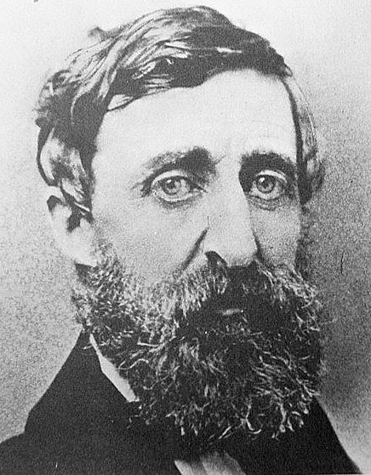
What is Transcendentalism?
Transcend (v.) means “to rise above or go beyond”
Began as a reform movement focusing on God’s presence in the individual
Is NOT a religion; it is a philosophy
Suggests that only by transcending the limits of reason and tradition can we seek our true potential as individuals
Henry David Thoreau

Slide 4
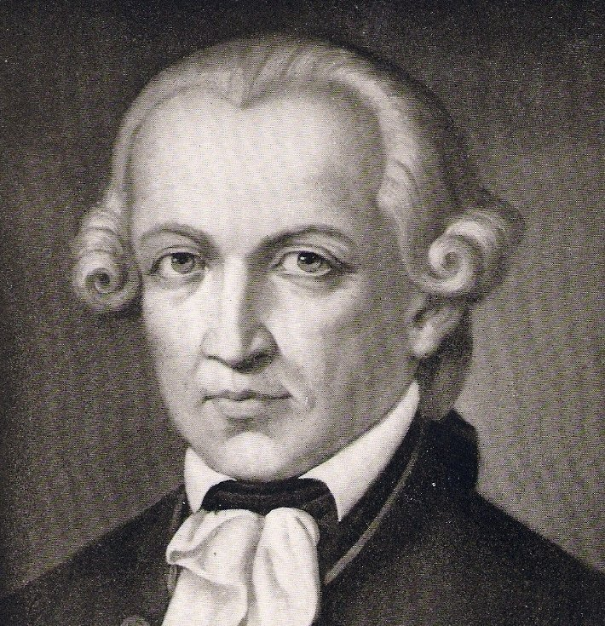
What is Transcendentalism? Cont’d
Two interpretations:
An ideal spiritual state that “transcends” the physical and the logical
A collection of eclectic ideas about literature, religion, social reform, and the general state of American culture
Immanuel Kant is given credit for popularizing the term “Transcendentalism” (mad props; it’s a huge word)
Immanuel Kant himself

Slide 5
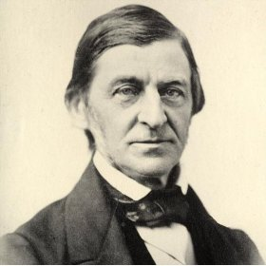
What is Transcendentalism? Cont’d
Key Tenets (beliefs)
“Transcendent forms” of truth exist beyond reason and experience. Each person is capable of discovering this truth through intuition.
People are inherently good and should follow their own beliefs.
Belief that humankind, nature, and God are all interconnected through the Over Soul (Emerson came up with this)

Slide 6
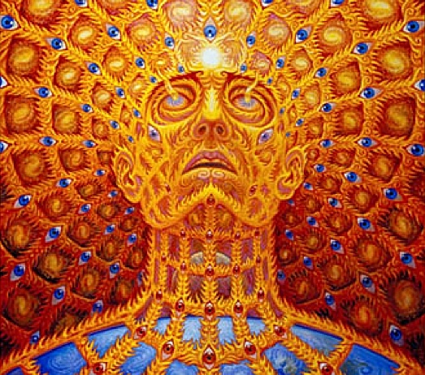
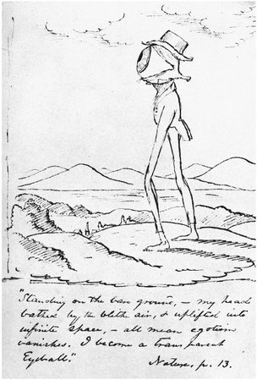
The Over Soul
“Transparent Eyeball” from Emerson’s essay “Nature”
From “Apocalypse How”

Slide 7
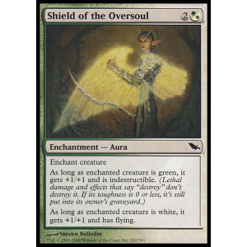
The Over Soul
How does this Magic: The Gathering card effect relate to Emerson’s theory of the Over Soul?
→→→→→→→→→→→→→→→→→→
←←←←←←←←←←←←←←←←

Slide 8
Characteristics of Transcendentalism
Emphasized living a simple life
Stressed a close relationship with nature
Celebrated emotions and the imagination
Stressed individualism and self-reliance
Believed intuition can lead to knowledge
Believed in inherent goodness in people
Encouraged spiritual well-being over financial well-being

Slide 9
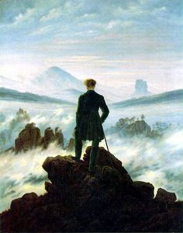
“Close Read” this painting using your notes
Wanderer Above the Sea of Fog,
By Caspar David Friedrich (1818)

Slide 10
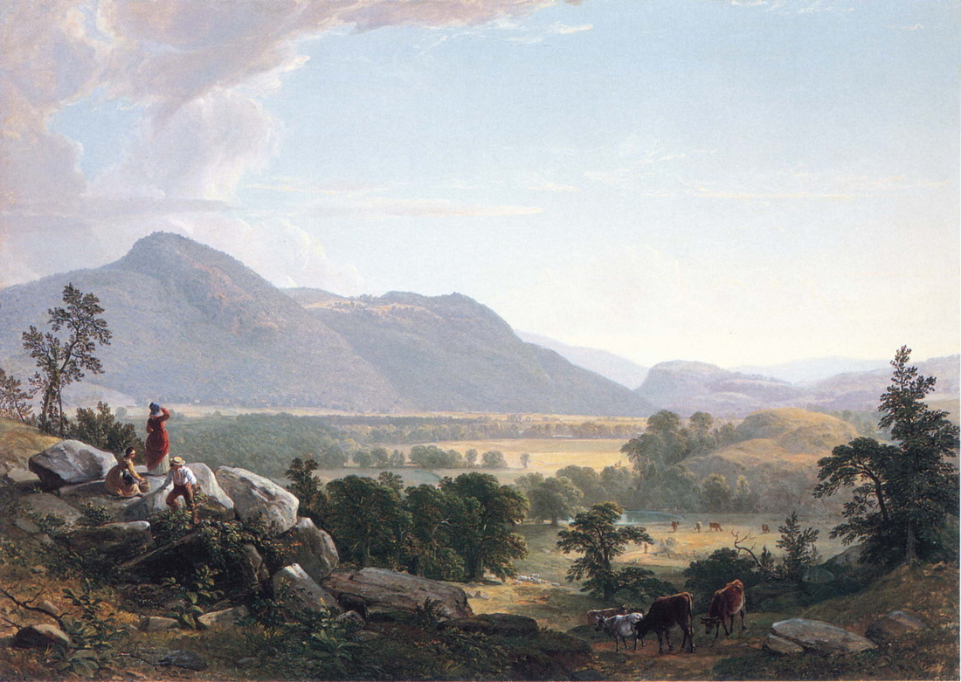
Dover Plane, Asher Durand (1848)

