Slide 1
William Shakespeare's Twelfth Night
A Truly Remarkable and Interactive Introduction by Mr. Haflin

Slide 2
Warm-Up
What are some characteristics of the Shakespearean Comedy? (2 mins)
The main action concerns LOVE
Would-be lovers must overcome obstacles
Deus Ex Machina— “God from Machine”
Harmonious Union; there’s a wedding, and we’re all invited!
Emphasis on SITUATIONS, NOT CHARACTERS

Slide 3
Stock Characters in a Shakespearean Comedy
Youthful Lovers
“Blocking Figures”
Parent/Guardian→sometimes creepily in love with their son/daughter
The Clever Servant (wicked, perhaps even MALevolent)
The Fool→and he’s not always wearing a hat
The braggart
Outlaws
Confidantes
Socially inferior helpers who aid their “superiors”

Slide 4
Historical Context—What do you know about The Bard? (2 mins)
Shakespeare was writing for a late 16th-Early 17th century audience, whose sense of humor is not much different than our own→genitalia jokes everywhere
Shakespeare competed with bear baiting, hangings, and mental asylums as forms of entertainment. (I guess he’s not so boring after all. Or maybe every other option was closed, so the peasants dragged their ragged selves over to the Globe theater)
All of the actors were men→ The actor playing Viola is a boy playing a girl who disguises herself as a boy (yeah, riddle me that)
Also, Shakespeare died on his 52nd birthday. Bummer.

Slide 5
Twelfth Night, or What You Will
Appears in Billy Shakes’s “First Folio”, published in 1623
“Twelfth Night” refers to the final night of Christmas Merrymaking, “the border of the celebration and the return to reality” (xiv).
“What You Will” interpretations→whatever happens, happens, whatever you want, or the sexual connotation of “will”.

Slide 6
Twelfth Night Themes
Unreliability of Language– Nietzsche, anyone?
Identity is difficult to define (both self and others)
Appearance vs. Reality
People like to deceive themselves AND others
The uncertainty of gender…WHICH LEADS US TO

Slide 7
Satire in Twelfth Night
Gender Roles and expectations
These roles aren’t much different that what we experience in this country on a daily basis
Women are weak, men are strong. Women are dependent, men are independent. Women are soft, men are…well, you get the idea
Laverne Cox →→→→

Slide 8
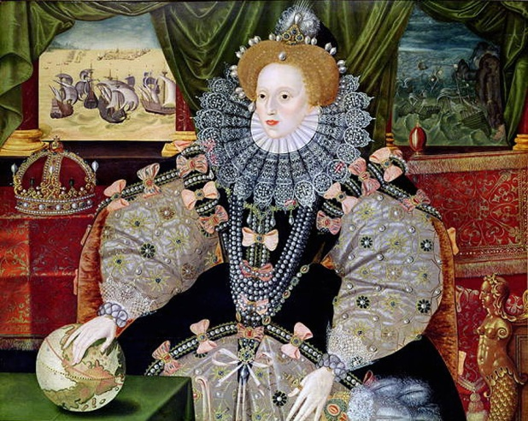
Satire in Twelfth Night, cont’d
Class struggle and expectations
Turned on their head for comedic effect

Slide 9
Question—What is Love?
Is love innate or socially constructed?
Now that we’ve solved that one (ish), how about this: What are some reasons that people get married?
Throughout the play, consider how love and marriage add to Shakespeare’s satirization of gender and class

Slide 10
Close Reading:
Orsino: (To Music Playing)
If music be the food of love, play on,
Give me excess of it that, surfeiting,
The appetite may sicken and so die.
That strain again, it had a dying fall.
O, it came o’er my ear like the sweet sound
That breathes upon a bank of violets,
Stealing and giving odour. Enough, no more,
‘Tis not so sweet now as it was before. (1-8)

Slide 11
Orsino, Cont’d:
O Spirit of love, how quick and fresh art thou
That, notwithstanding thy capacity
Receiveth as the sea, naught enters there,
Of what validity and pitch so e’er,
But falls into abatement and low price
Even in a minute! So full of shapes is fancy
That it alone is high fantastical.
Curio: Will you go hunt, my lord? (I.i.16)

