Slide 1
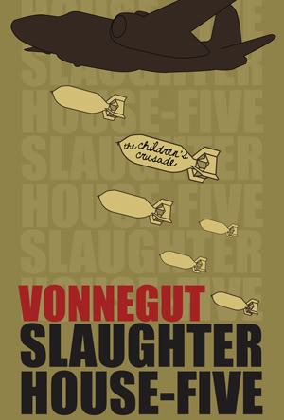
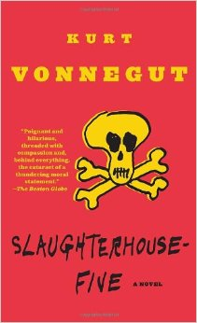
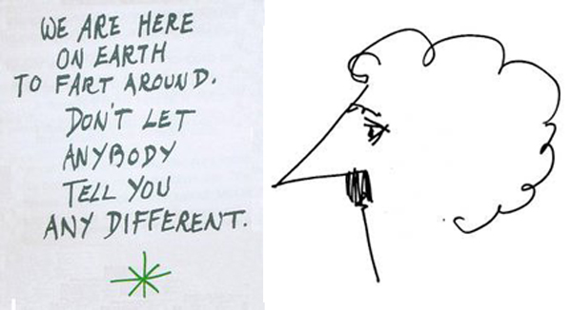
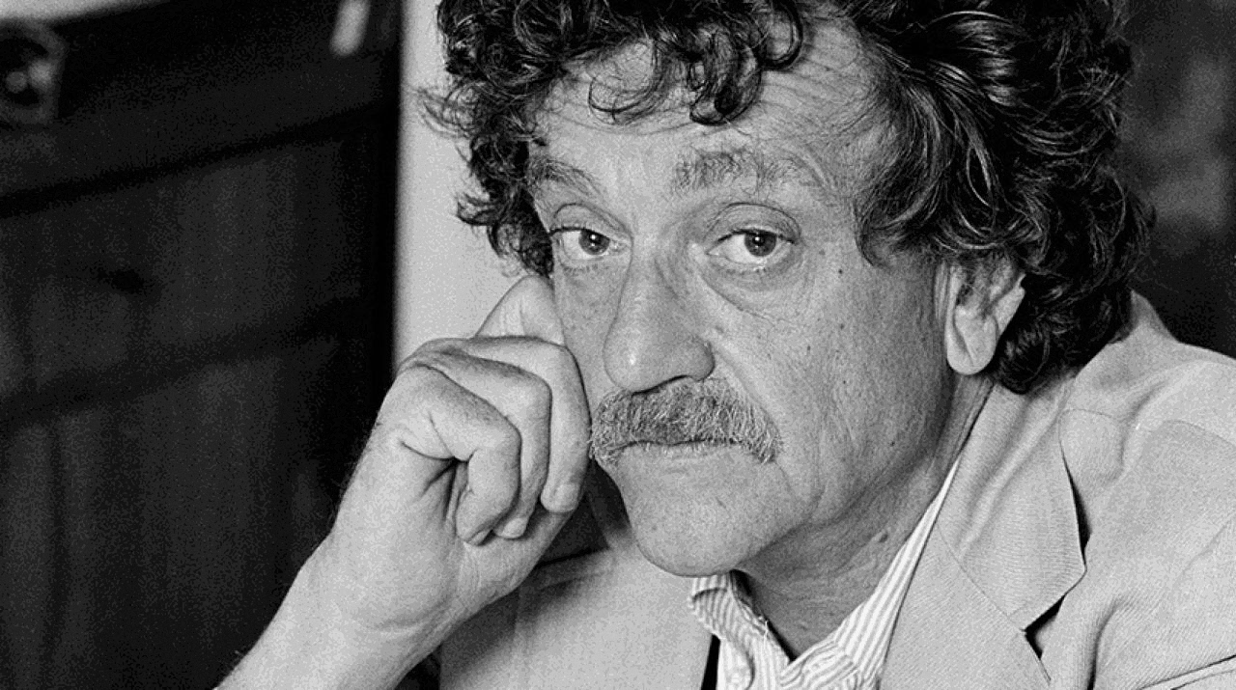
Kurt Vonnegut’s Slaughterhouse Five, or The Children’s Crusade
http://www.cc.com/video-clips/1q89v2/the-daily-show-with-jon-stewart-kurt-vonnegut
What kind of guy is Kurt Vonnegut?
http://www.nytimes.com/1969/03/31/books/vonnegut-slaughterhouse.html?_r=0

Slide 2
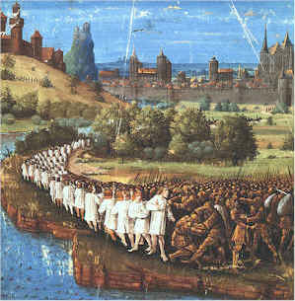
Children’s crusade
Why?
1212
Christians versus Muslims
Contested validity
Does it matter?

Slide 3
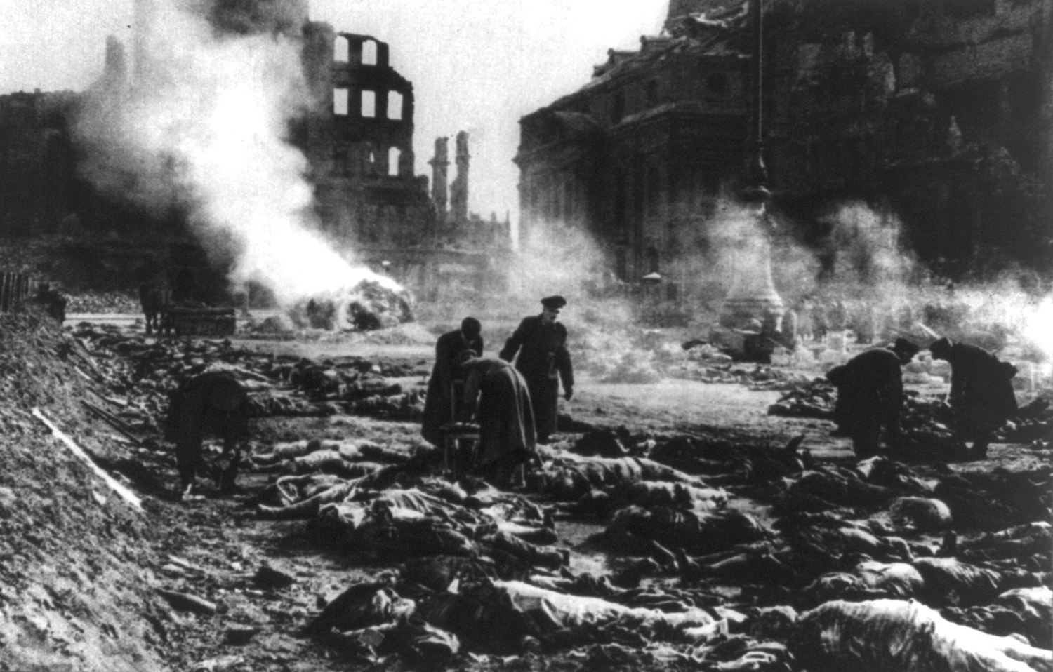
Firebombing
a bombing technique designed to damage a target, generally an urban area, through the use of fire, caused by incendiary devices, rather than from the blast effect of large bombs.

Slide 4
Firebombing

Slide 5
Firebombing

Slide 6
Dresden, Germany

Slide 7
Dresden, Germany
Once one of the most cultured cities in Europe
Museums
Incredible architecture
“Florence of the Elbe”
http://www.history.com/topics/world-war-ii/battle-of-dresden
Probably around 135,000 civilians killed

Slide 8
After the bombings

Slide 9
After the bombings

Slide 10
Satire in Vonnegut
We should constantly be asking what he is criticizing or noticing
Major themes include war, human apathy, the nonsensical nature of violence, and (on a less satirical note) the ability (questionable though it is) of people to affect change in small ways

Slide 11
Science Fiction
Why explore different worlds?
What could the possible use be of science fiction?
How does it affect or contribute to the Vonnegut’s unique brand of satire?

