Slide 1
Philosophy and Twelfth Night
Locke, Hobbes, and Nietzsche

Slide 2
John Locke
"He and all the rest of mankind are one community, make up one society distinct from all other creatures. And were it not for the corruption, and viciousness of degenerate men, there would be no need of any other; no necessity that men should separate from this great and natural community, and by positive agreements combine into smaller and divided associations" (Second Treatise, Chapter 9).

Slide 3
Thomas Hobbes
“No society; and which is worst of all, continual fear, and danger of violent death; and the life of man, solitary, poor, nasty, brutish, and short” (Leviathan)
Leviathan—monster

Slide 4
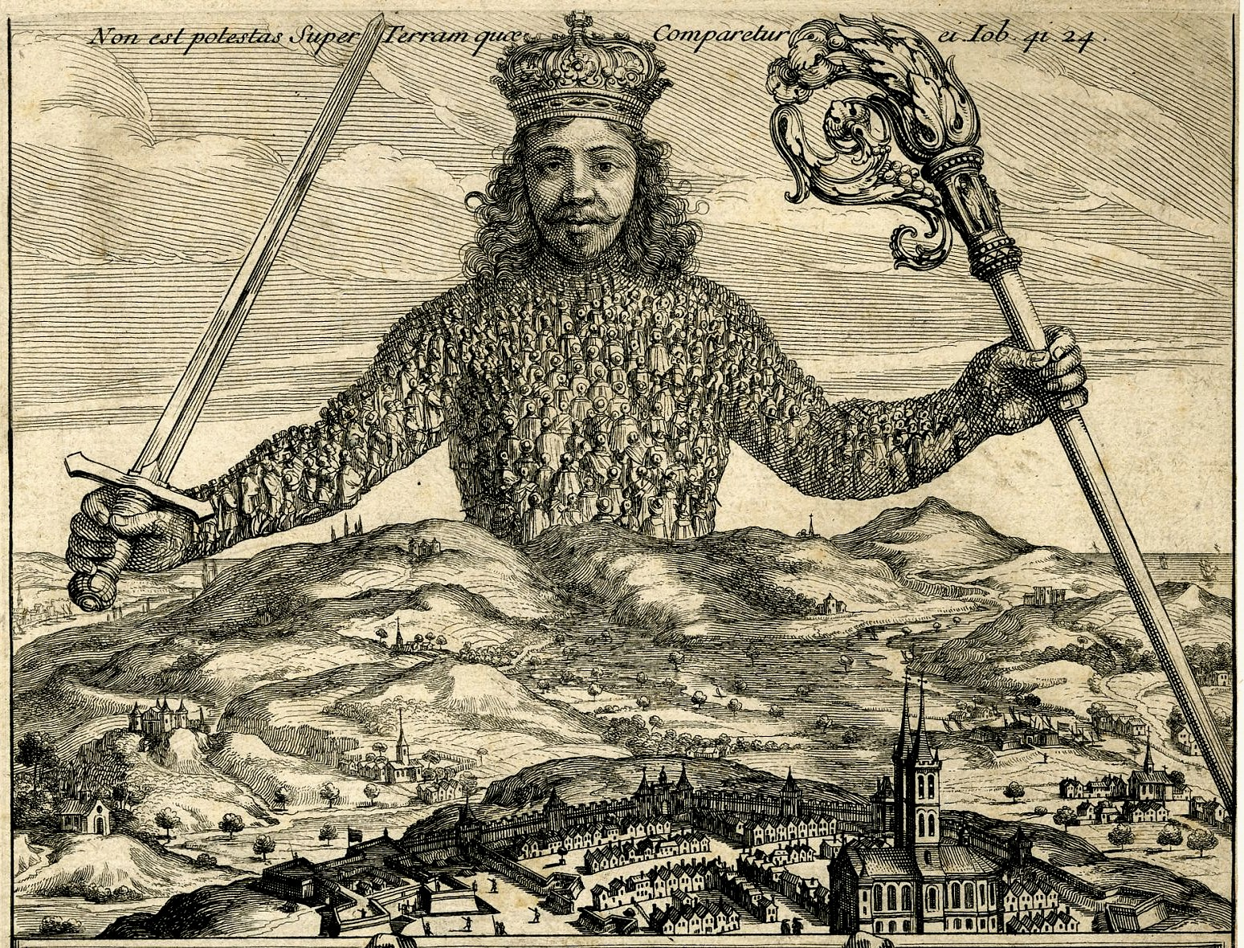

Slide 5
A Question (or Two)
Which theory do you believe is correct?
How is this discussion relevant to Twelfth Night?

Slide 6
Friedrich Nietzsche- Binary Oppositions
Almost all problems that philosophy attempts to solve can be summed up thusly: “How can something originate in its opposite, for example rationality and irrationality, logic in illogic…metaphysical philosophy has hitherto surmounted this difficulty by denying that the one originates in the other and assuming for the more highly valued thing a miraculous source in the very kernel and being of the ‘thing in itself’” (Nietzsche Reader 53).

Slide 7
Nietzsche Binary Question
What are some binary oppositions that you know of?
What are some binary oppositions in Twelfth Night?
See the Gender and Race Binary Oppositions
Which is “better”? Why? EXAMPLES?
Lil Dicky’s “White Dude”
https://www.youtube.com/watch?v=3rnFlQAvk8U

Slide 8
Nietzsche on Language
“…mankind set up in language a separate world beside the other world, a place it took to be so firmly set that, standing upon it, it could lift the rest of the world off its hinges and make itself master of it” (“Language as Putative Science”, 55)
“[Man] really thought that in language he possessed knowledge of the world” (55).
Language is an imperfect tool for understanding our world.
Think of instances in which language muddles and befuddles our understanding of a situation.

Slide 9
Nietzsche on Freedom
“Over one man necessity stands in the shape of his passions, over another as the habit of hearing an obeying, over a third as a logical conscience, over a fourth as caprice and a mischievous pleasure in escapades. These four will, however, seek the freedom of their will precisely where each of them is most firmly fettered” (57).
…”each considers himself free where his feeling of living is greatest…in passion, duty, knowledge, and mischievousness, respectively (57).

Slide 10
Freedom Writing Diary
Where do you consider yourself to be “most free”? Does this aspect of your life coincide with passion, duty, knowledge, or mischievousness?
Share (by volunteer basis)

