Slide 1
A Quick Review
"It's one of those universal American stories," said Ferguson after being informed of Weaver's choice to read the Cliffs Notes instead of the pocket-sized novel. "I look forward to skimming her essay on the importance of following your dreams and randomly assigning it a grade.”
Within an hour of completing the cliffs notes, Weaver was already telling friends and classmates that Steinbeck was her favorite author, as well as reciting select quotations from the "Important Quotations" section for their benefit.

Slide 2
Hingham, MA – Local high school English teacher Zachary Raymond is leading the environmental campaign in class by drastically reducing paper usage and encouraging students to recycle and compost uneaten fruits and veggies.
Raymond, who conducted the interview through his car window, commended: “it’s really the least I can do for the environment, especially considering the complete incompetence of the school’s student-led green team,” who were advocating for an important global warming bill in Washington D.C., and unavailable for comment.
One of Zach’s newest campaigns involves electronically posting homework on the web rather than printing it out on wasteful copy paper. Commenting on this remarkable innovation, Raymond explained “By not having to print out papers, I’ve saved 100s of acres of forest land.”
When asked if he would care to come inside for a drink, Raymond graciously accepted, leaving his car running so as not to let it get cold. He apologized for his overflowing satchel of student homework, adding that he needed to catch up on grading the homework, which students are required to print.
“It’s one of those universal American stories,” said Ferguson after being informed of Weaver’s choice to read the Cliffs Notes instead of the pocket-sized novel. “I look forward to skimming her essay on the importance of following your dreams and randomly assigning it a grade.”
Within an hour of completing the cliffs notes, Weaver was already telling friends and classmates that Steinbeck was her favorite author as well as reciting select quotations from the “Important Quotations” section for their benefit.

Slide 3
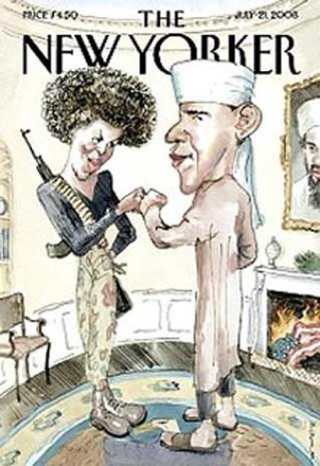

Slide 4
Limits of Satire?
Do you think Charlie Hebdo, the French satirical newspaper, should have published caricatures of the Prophet Muhammad and other controversial sketches?

Slide 5


Slide 6
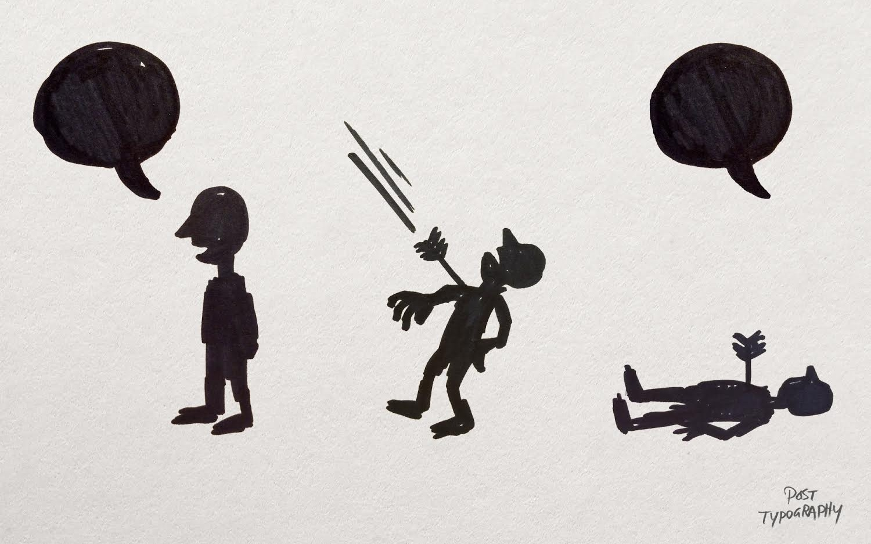

Slide 7
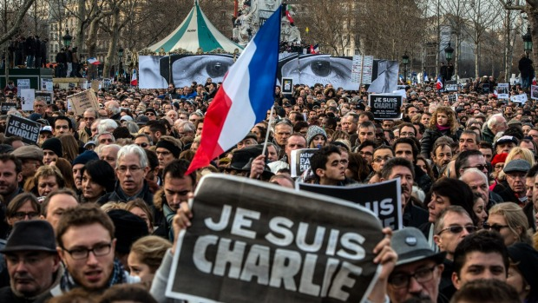

Slide 8
One Perspective
But their work featuring Mohammed could be sophomoric and racist. Not all of it; a cover image of the prophet about to be beheaded by a witless ISIS thug was trenchant commentary on how little Islamic radicalism has to do with the religion itself. But often, the cartoonists simply rendered Islam’s founder as a hook-nosed wretch straight out of Edward Said’s nightmares, seemingly for no purpose beyond antagonizing Muslims who, rightly or wrongly, believe that depicting Mohammed at all is blasphemous.
So Charlie Hebdo’s work was both courageous and often vile. We should be able to keep both of these realities in our minds at once, but it seems like we can’t.
Free speech allows us to say hateful, idiotic things without being punished by the government. But embracing that right means that we need to acknowledge when work is hateful or idiotic, and can’t be defended on its own terms.
We have to point out when an “edgy” cartoon is just a crappy Islamophobic jab.

Slide 9
Another Perspective
Witch burnings, heresy trials, and the untiring work of the Inquisition shaped Europe, and these ideas extended into American history and took on American modes, from the breaking of slaves to the censuring of critics of Operation Iraqi Freedom.
It is not always easy to see the difference between a certain witty dissent from religion and a bullyingly racist agenda, but it is necessary to try. Even Voltaire, a hero to many who extol free speech, got it wrong. His sparkling and courageous anti-clericalism can be a joy to read, but he was also a committed anti-Semite, whose criticisms of Judaism were accompanied by calumnies about the innate character of Jews.
But it is possible to defend the right to obscene and racist speech without promoting or sponsoring the content of that speech. It is possible to approve of sacrilege without endorsing racism. And it is possible to consider Islamophobia immoral without wishing it illegal. Moments of grief neither rob us of our complexity nor absolve us of the responsibility of making distinctions
The only person in prison for the C.I.A.’s abominable torture regime is John Kiriakou, the whistle-blower. Edward Snowden is a hunted man for divulging information about mass surveillance. Chelsea Manning is serving a thirty-five-year sentence for her role in WikiLeaks. They, too, are blasphemers, but they have not been universally valorized, as have the cartoonists of Charlie Hebdo.
http://www.newyorker.com/culture/cultural-comment/unmournable-bodies

Slide 10
Moving Forward
“The vast majority of Muslims of course have nothing to do with the insanity of such attacks — except that they are disproportionately the victims of terrorism.”
“So let’s avoid religious profiling. The average Christian had nothing to apologize for when Christian fanatics in the former Yugoslavia engaged in genocide against Muslims.”
“Let’s also acknowledge that the most courageous, peace-loving people in the Middle East who are standing up to Muslim fanatics are themselves often devout Muslims.”

Slide 11
Final Discussion Points
Should there be limits to satire?
When does satire fail?

